Slide 1
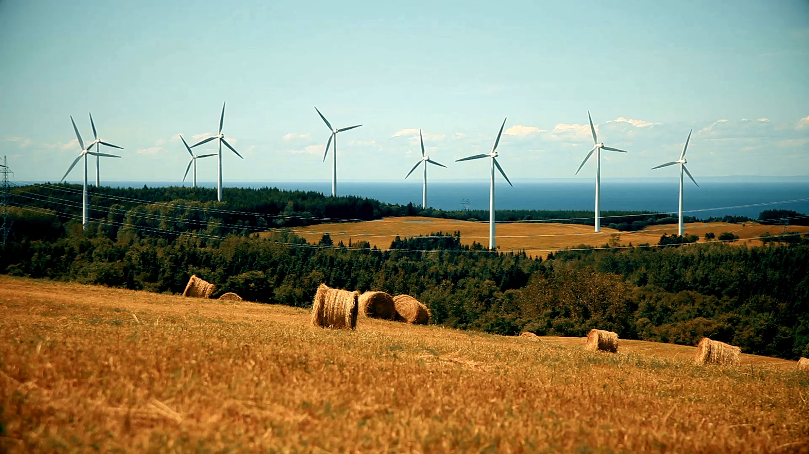
On Track?: A Dive Into Renewable and Non-Renewable Energy
By: Tabitha Diaz
Notes:
- Hello all! My name is Tabitha Diaz, and this is my presentation On Track?: A Dive Into Renewable and Non-renewable energy.
- For the last few years, if not longer, we have heard that the way we produce energy is actively affecting our climate for the worse, we have experienced this firsthand through heatwaves, droughts, extreme flooding, and constant natural disasters, that seem to get worse throughout the world.
- I wanted to investigate the numbers and see if we our on our way to reducing non-renewable energy around the world by taking a look at two of the major players: China and the USA.

Slide 2
Contents List
Introduction
Electricity Around the World
Yearly Net Electricity Capacity
Top 10 Breakdown
The Top 10 Countries by Renewable Capacity
Comparison Between China and the U.S.
Renewable Energy Capacity
Forecast for the Future
Are We On Track?
Thank You!

Slide 3

Introduction
Net installed energy capacity is defined as:
The maximum amount of electricity that a generating station (also known as a power plant) can produce under specific conditions designated by the manufacturer.
The Paris Agreement is an agreement with over 180 countries to reduce greenhouse gas emissions and reach net zero by 2050.
In order to achieve this the IEA states that almost two-thirds of electricity generation needs to be renewable by 2030.
Since 2019 around 90% of the world’s population has had access to electricity.
Notes:
Thank you for giving me a second of your time to discuss Renewable and Non-renewable regarding net installed capacity energy numbers between 1990-2019 (data was incomplete for 2020 and has been excluded).
- Net installed energy capacity is defined as:
- The maximum amount of electricity that a generating station (also known as a power plant) can produce under specific conditions designated by the manufacturer.
It is also important to note that my analysis is through the lens of the Paris Agreement.
- The Paris Agreement is an agreement signed in 2015 and put into effect in 2016 with over 180 countries to reduce greenhouse gas emissions and reach net zero by 2050.
- In order to achieve this the IEA states that almost two-thirds of electricity generation needs to be renewable by 2030.
Since 2019 around 90% of the world’s population has had access to electricity.
But how do we generate electricity?

Slide 4
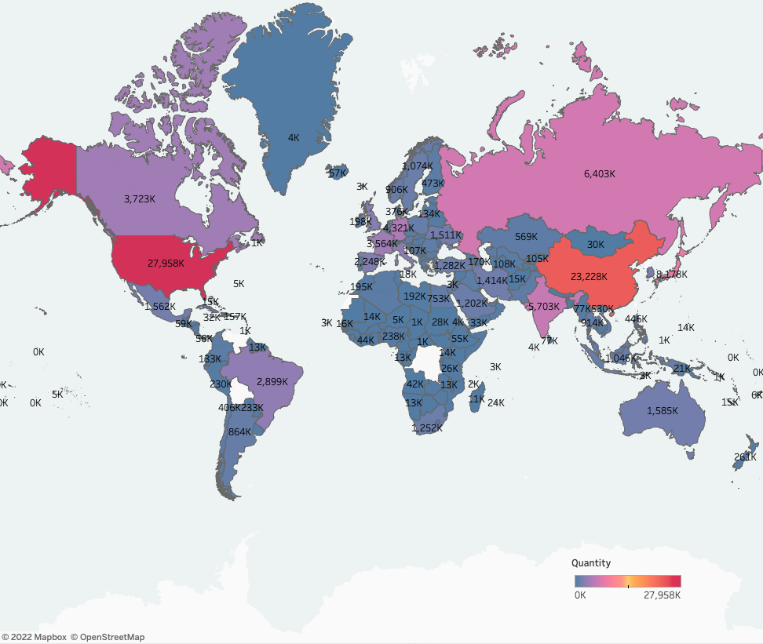
Electricity Around the World
The biggest players:
United States
China
Japan
Russia
India
Germany
Canada
France
Brazil
Italy
Notes:
-From this map you can see that most of the world currently has electricity, as mentioned before over 90% of the world has had access to electricity, but how much they can produce/store and the methods vary greatly.
The biggest players:
United States
China
Japan
Russia
India
Germany
Canada
France
Brazil
Italy
-When I saw this map, I wanted to see how the two big players China and the United States are doing but before getting to them let’s look at the yearly net electricity capacity of the world.

Slide 5
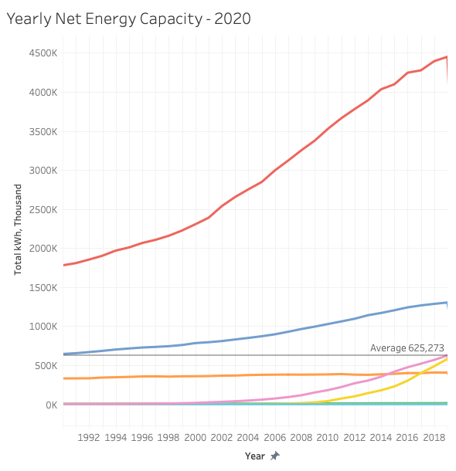
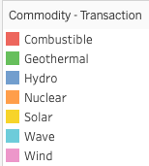
Yearly Net Electricity Capacity
Since 1990 net installed combustible energy has continued to grow at a rapid pace around the world.
Currently, 66% of all net installed energy is combustible.
Hydro follows next with just 21% of all net installed energy around the world.
Notes:
- Since 1990 net installed combustible energy has continued to grow at a rapid pace around the world, represented by the top red line.
- Significantly, above the average of every other form of installed energy.
- Currently, 66% of all net installed energy is combustible.
- Hydro follows next with just 21% of all net installed energy around the world.
- Even with hydro energy being 21%, you can see from the graph a little over 1/3 of the net installed electricity capacity is renewable.
-How would this look when broken down by the top10 countries?

Slide 6
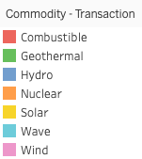
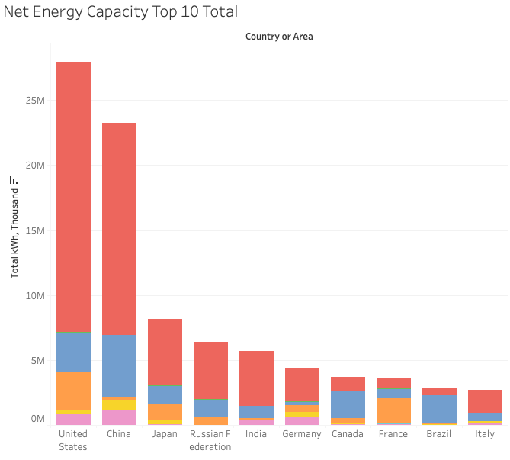
Top 10 Breakdown
The United States and China have the largest net installed electricity numbers overall.
The only countries with a net installed energy capacity that aren’t reliant of combustibles are Canada, France, and Brazil.
Notes:
From this chart we can see that a majority of the top 10 are reliant on Non-Renewable forms of energy production as their net installed capacity.
The United States and China have the largest net installed electricity numbers overall.
With the largest net capacity of combustible.
The only countries with a net installed energy capacity that aren’t reliant of combustibles are Canada, France, and Brazil.
Canada being hydro
France being nuclear
Brazil being hydro
Now, how would the top 10 look when broken down by their renewable capacities.

Slide 7
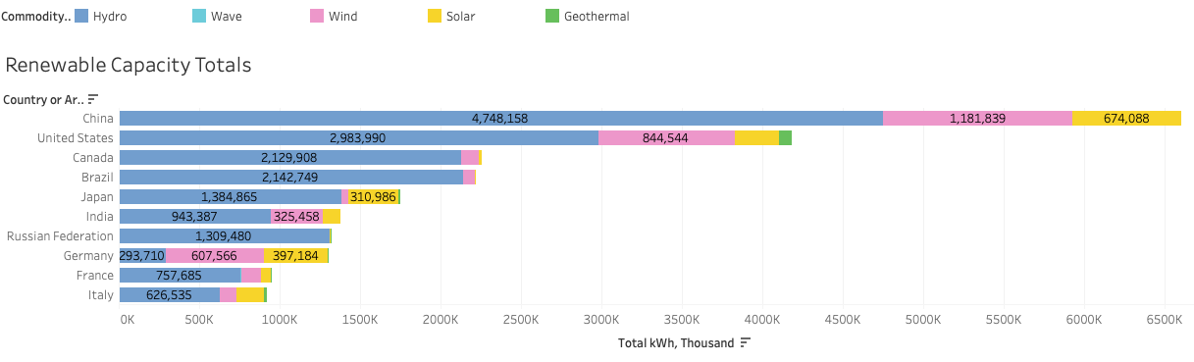
The Top 10 Countries by Renewable Capacity
When it comes to renewable net installed capacity China and the US have swapped places.
The most renewable net installed energy capacity for all countries, with the exception of German, is hydro.
Notes:
When it comes to renewable net installed capacities China and the US have swapped places.
The most renewable net installed energy capacity for all countries, apart from German, is hydro
It is clear from this chart that China has significantly outpaced its counterparts with renewable energy.

Slide 8
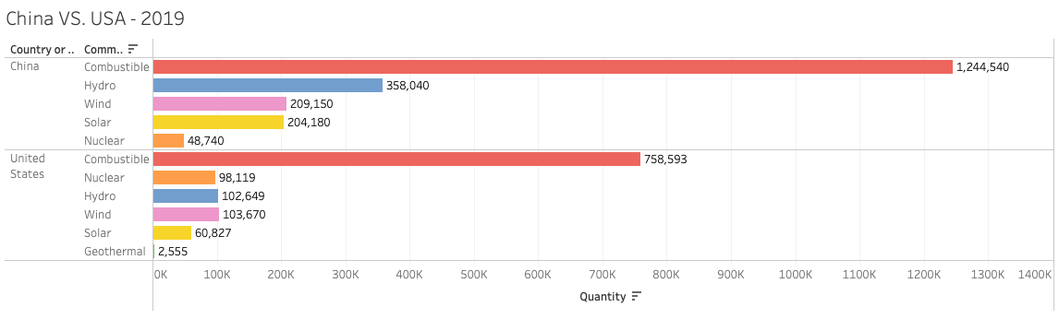
Comparison Between China and the U.S.
In 2019, China has a net installed combustible capacity a little under double of the US.
However, as we have seen in the previous slides the US has an overall larger net installed capacity for combustibles.
Notes:
- In 2019, China has a net installed combustible capacity a little under double of the US.
- Though that is the case – China has also triple the net installed capacity for hydro (in blue) and solar (in yellow) and double for wind (in purple) than the US.
- However, as we have seen in the previous slides the US has an overall larger total net installed capacity for combustibles.
- Even though their number for combustible net installed capacity is lower than China’s in 2019

Slide 9
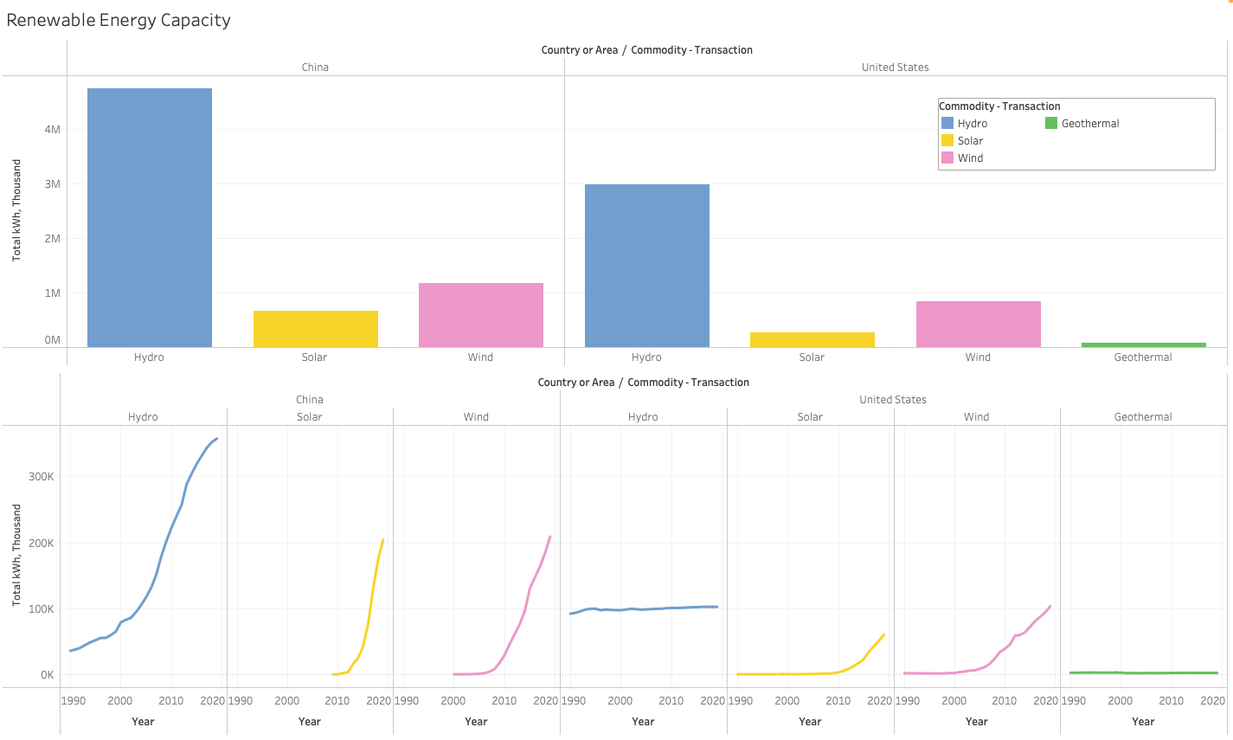
Renewable Energy Capacity
Since 1990 China has significantly improved their hydro net installed capacity.
The US has had little to no change since 1990.
In the last few decades China has grown in both solar and wind energy.
In comparison the US is growing in solar and wind but not nearly as quickly as China.
Notes:
It wasn’t only important to understand how China and the US numbers compared to each other but ALSO to note the growth they have made yearly.
Since 1990 China has significantly improved their hydro net installed capacity.
Growing 10X since 1990.
The US has had little to no change in hydro since 1990.
In the last few decades China has grown in both solar and wind energy at a faster rate than the US.
Even though China only began working with solar in 2009 and wind 2000.
In comparison the US is growing in solar and wind but not nearly as quickly as China.

Slide 10
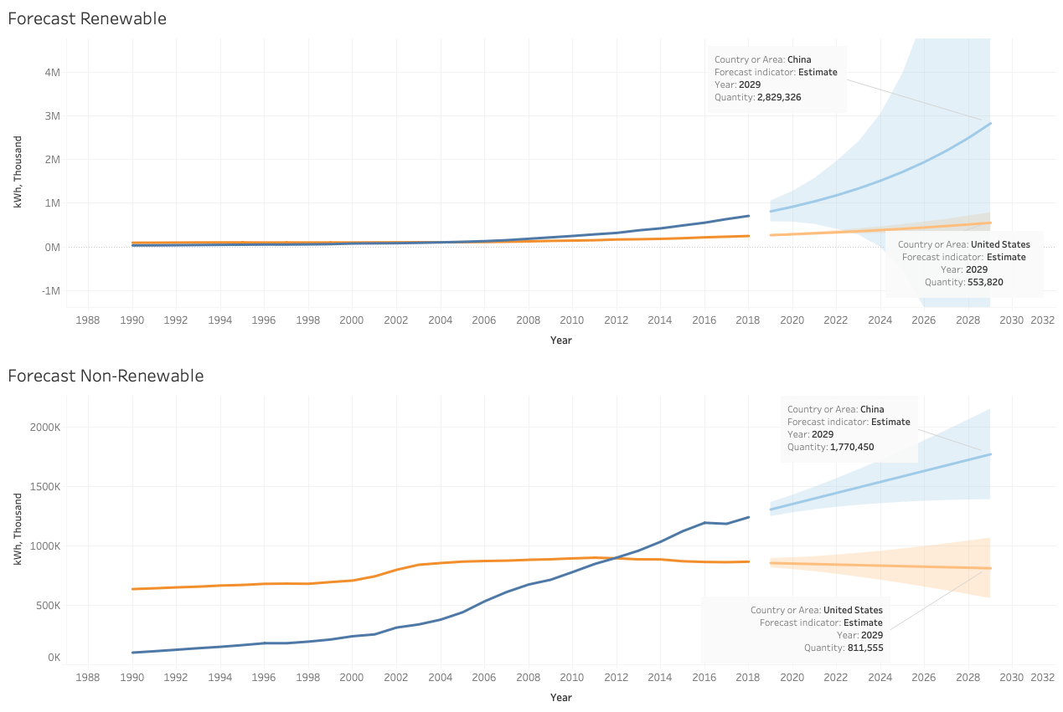
Forecast For The Future
In the next 8 years we are seeing a promising increase from China and renewable energy sources.
The US may not be growing tremendously in renewable energy but in the next few years there will be a slight decline in non-renewable energy sources.
Notes:
- In the next 8 years we are seeing a promising increase from China and renewable energy sources.
- The US forecast isn’t looking that great – only increasing slightly over the next 8 years.
- The US may not be growing tremendously in renewable energy but in the next few years there will be a slight decline in non-renewable energy sources.
- From my analysis, China is overall more renewable than the US, and has a bright future in being a leader in renewable energy, but is it enough to align with the standard set with the Paris Agreement?

Slide 11
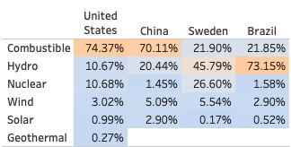
Are We On Track?
China and The United States are not on track to be 2/3 renewable by 2030.
For this to improve there needs to be a quicker transition from non-renewable energy to renewable energy.
Both countries can no longer keep growing in non-renewable energy
Brazil and Sweden are already ahead of the curve with over 77% renewable energy.
Current % of Net Energy Capacity
Notes:
Unfortunately, we are not on track for the 2030 goal of 2/3 renewable energy BUT the US and China are making great strides.
From the previous slide China will be around 61% Renewable (39% non-renewable) by 2030 if it continues at this pace just 5% short of 2/3.
The US will be around 41% renewable and (69% non-renewable) by 2030.
- They skew the protentional of reaching our climate goals because they are the biggest players in renewable and non-renewable energy, which is why I choose to focus on them today.
- As a result, both countries can no longer keep growing in non-renewable energy as their ventures in renewable energy don’t compensate for such growth.
The world needs to do better at transitioning from non-renewable to renewable energy especially within the biggest producing countries.
And we can see it is already possible with countries like Brazil and Sweden being over 77% renewable energy.
In conclusion, China is more Renewable and more on track to being 2/3 renewable than the US by 2030 but there is still a lot of work to be done if we ever want to fall in line with the Paris Agreement.

Slide 12
Thank You!
Interactive visualizations can be found here.
Sources: IEA – Net Zero by 2050
Notes:
Thank you all for your time!
Link to Tableau : https://public.tableau.com/app/profile/tabitha.diaz/viz/shared/KY65MZDSP

